Slide 1
General User Pages

Slide 2
Login Page
Logo
Username:
Password:

Slide 3
Manager Pages

Slide 4
Default Manager Web Template
Logo
Jobs
Routes
Logout

Slide 5
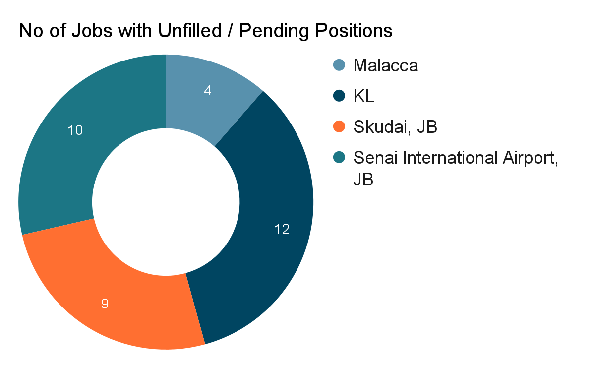
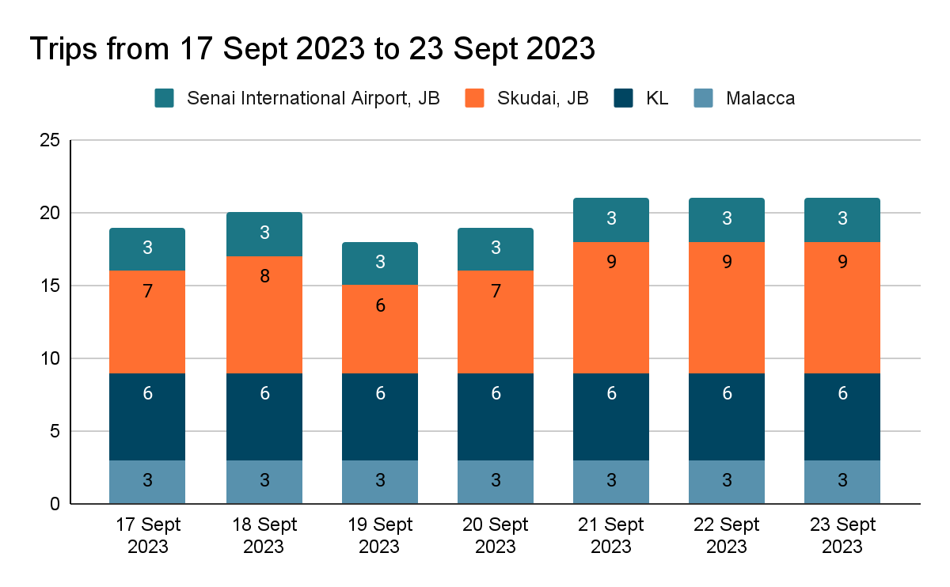
Landing Page
Logo
Jobs
Routes
Logout
Filter:
Week View
Staff with Highest Workload
Staff A – 50 Hours
Staff B – 44 Hours
Staff C – 40 Hours
Staff with Lowest Workload
Staff X – 0 Hours
Staff Y – 5 Hours
Staff Z – 20 Hours
Pending Job Rejection Requests
Staff A – 20 Sept 2023 6:00PM, SG →Senai Intl Airport
Staff D - 23 Sept 2023 12:00PM, SG → KL
…

Slide 6
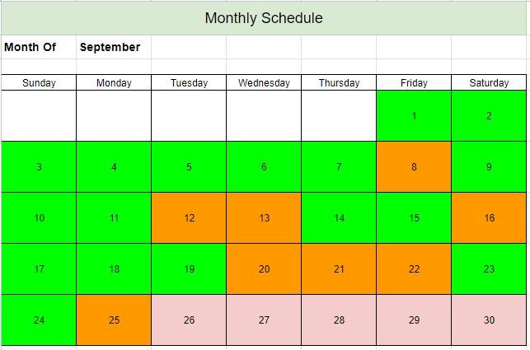
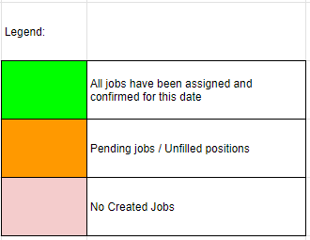
Monthly Job Schedule
Logo
Jobs
Routes
Logout
Select a Date to view more information

Slide 7
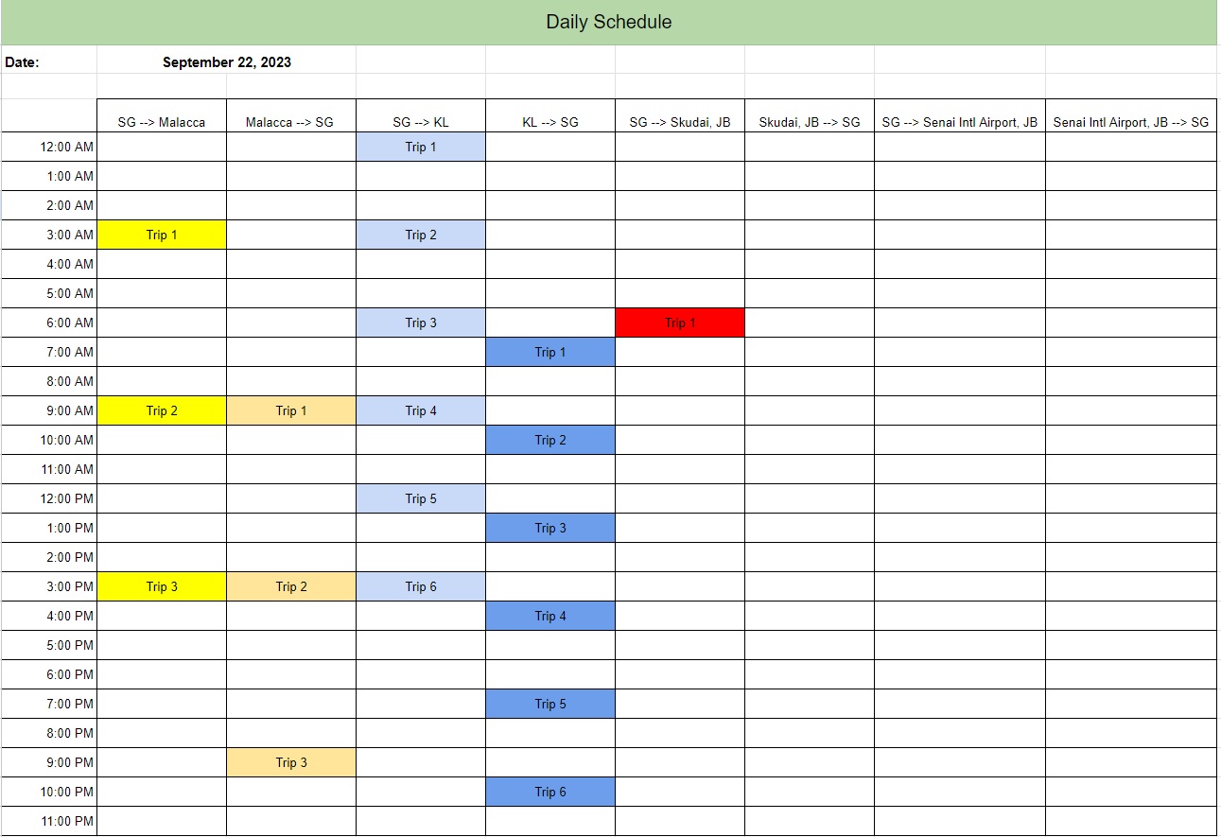
Route Creation / Modification Page- Trip less than 2 hours
Logo
Jobs
Routes
Logout
Trip Details
Date:
22 September 2023
Trip Route:
SG → Skudai, JB
Trip Duration:
0.5 Hours
Trip Departure Time:
8:00 AM
Bus Driver 1:
Add Bus Driver
Staff A
Crew Member 1:
Add Crew Member
Staff C
Submit
Discard Changes
Notes:
manager click any slot
manager determines trip direction and trip timing
based on trip direction, system determines min number of bus drivers and crew members
eg trip less than 2 hours, min 1 bus driver and 0 crew member
trip more than 2 hours, min 2 bus driver and 1 crew member
to modify, manager click created trip and system will auto populate details, then manager can change details accordingly
eg one guy cmi, then manager can change cmi fella to “3rd party”

Slide 8
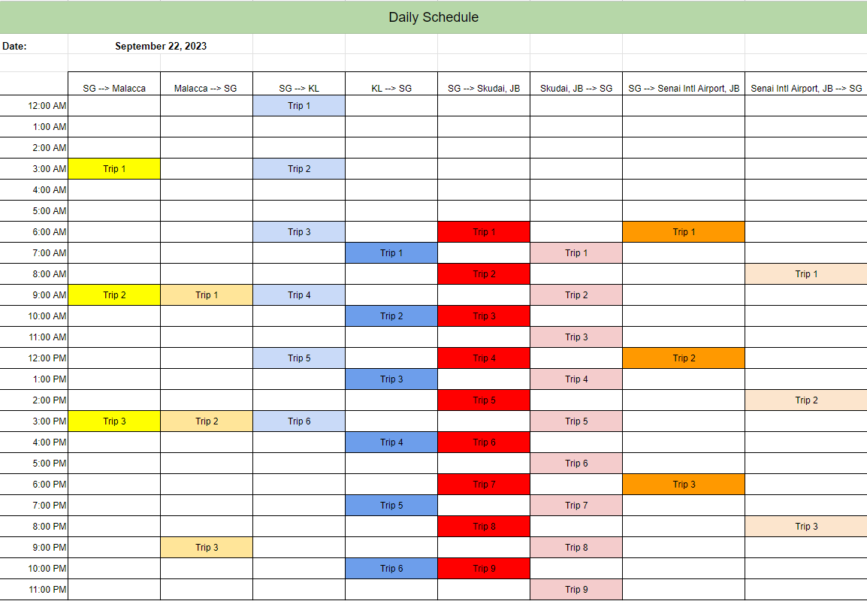
Route Creation / Modification Page - Trip more than 2 hours
Logo
Jobs
Routes
Logout
Trip Details
Date:
22 September 2023
Trip Route:
SG → Malacca
Trip Duration:
5 Hours
Trip Departure Time:
3:00 PM
Bus Driver 1:
Add Bus Driver
Staff A
Bus Driver 2:
Staff B
Crew Member 1:
Add Crew Member
Staff C
Submit
Discard Changes

Slide 9
Rejection Requests Page
Logo
Jobs
Routes
Logout
Status:
Unresolved
Name of Staff: Staff A
Trip Date: 20 September 2023, 6:00PM
Trip Details: SG → Senai Intl Airport, JB
Current Demerit Points: 0
Reason for rejection: Too many work hours this week
Staff Name:
Date Sort:
Ascending
View
5
Of
10
Staff X
Trip Date: 18 Sept 2023, 3:00AM
Trip Details: SG → KL
Staff A
Trip Date: 20 Sept 2023, 12:00PM
Trip Details: SG -> Senai Intl Airport, JB
Staff A
Trip Date: 20 Sept 2023, 6:00PM
Trip Details: SG → Senai Intl Airport, JB
Accept Rejection Request
Deny Rejection Request
Staff D
Trip Date: 23 Sept 2023, 12:00PM
Trip Details: SG -> KL
Staff F
Trip Date: 24 Sept 2023, 3:00PM
Trip Details: SG -> Malacca

Slide 10
Crew Member Pages

Slide 11
Default Crew Member Web Template
Logo
Availability Indication
Pending Job Assignments
Logout

Slide 12
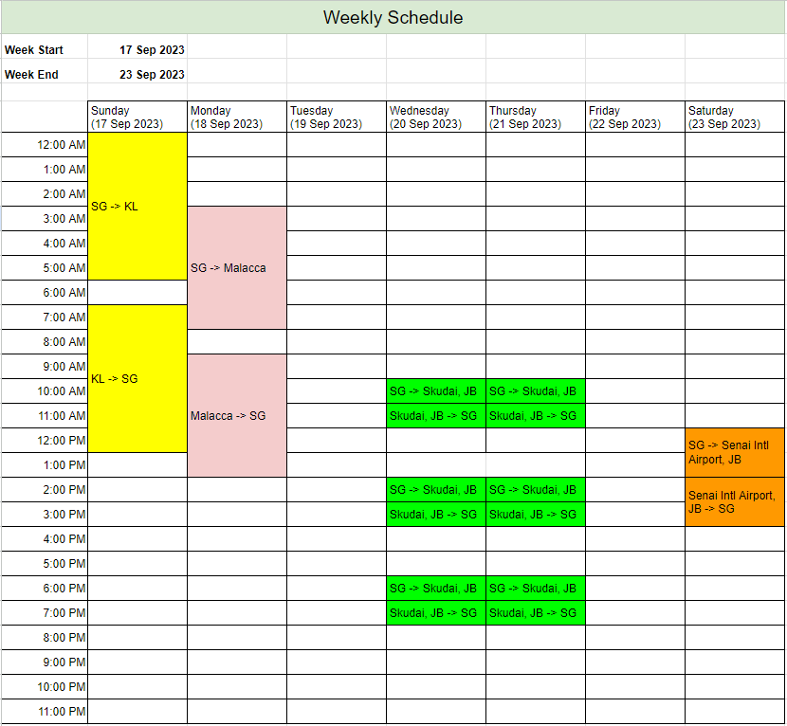
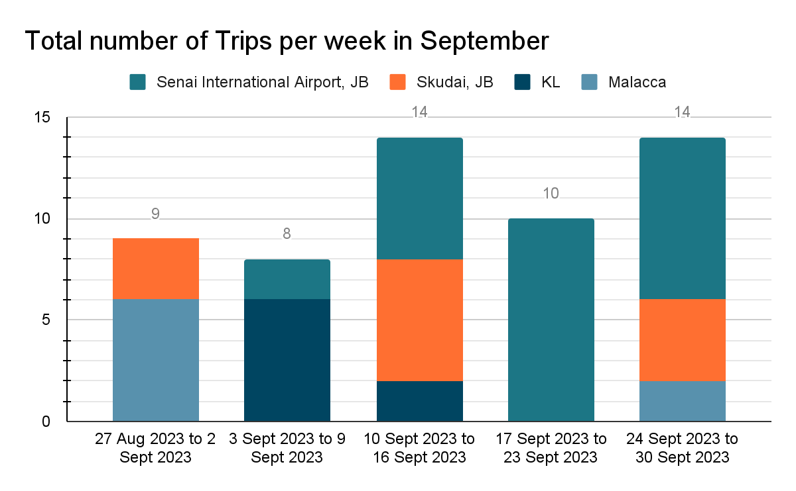
Landing Page
Logo
Availability Indication
Pending Job Assignments
Logout

Slide 13
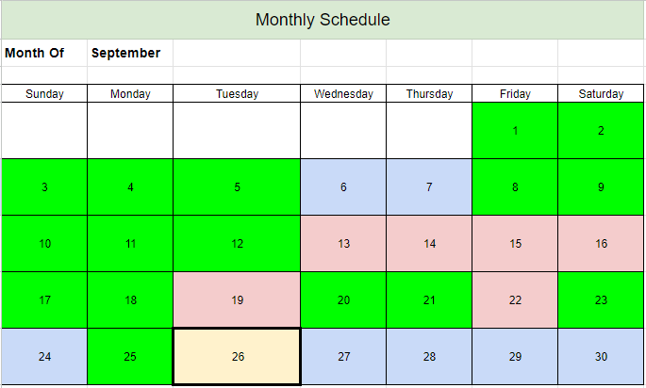
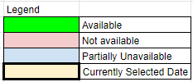
Availability Indication Page
Logo
Availability Indication
Pending Job Assignments
Logout
Date: 26 September 2023
Available timings:
Early Morning:
Morning:
Afternoon:
Evening:
12:00 - 1:00 AM
1:00 - 2:00 AM
2:00 - 3:00 AM
3:00 - 4:00 AM
4:00 - 5:00 AM
5:00 - 6:00 AM
6:00 - 7:00 AM
7:00 - 8:00 AM
8:00 - 9:00 AM
9:00 - 10:00 AM
10:00 - 11:00 AM
11:00 AM - 12:00 PM
12:00 - 1:00 PM
1:00 - 2:00 PM
2:00 - 3:00 PM
3:00 - 4:00 PM
4:00 - 5:00 PM
5:00 - 6:00 PM
6:00 - 7:00 PM
7:00 - 8:00 PM
8:00 - 9:00 PM
9:00 - 10:00 PM
10:00 - 11:00 PM
11:00 PM- 12:00 AM
All Available
All Not Available
All To Be Confirmed

Slide 14
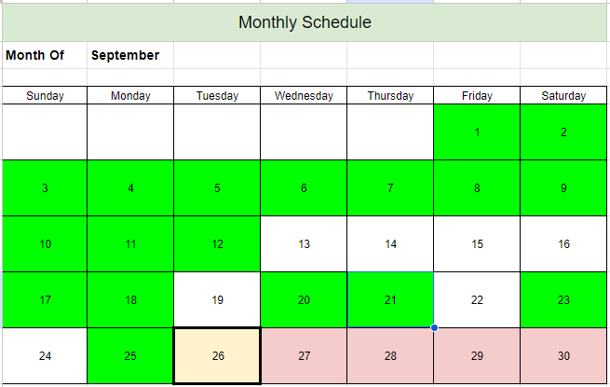
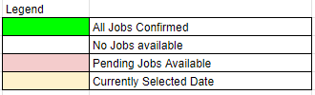
Pending Job Assignments Page
Logo
Availability Indication
Pending Job Assignments
Logout
Date: 26 September 2023 View 5 of 6
Trip Destination: SG → Senai Intl Airport, JB
Trip Departure Time: 06:00 AM
Confirm
Reject
Trip Destination: Senai Intl Airport, JB → SG
Trip Departure Time: 08:00 AM
Confirm
Reject
Trip Destination: SG → Skudai, JB
Trip Departure Time: 12:00 PM
Confirm
Reject
Trip Destination: Skudai, JB→ SG
Trip Departure Time: 01:00 PM
Confirm
Reject
Trip Destination: SG → Skudai, JB
Trip Departure Time: 04:00 PM
Confirm
Reject

Slide 15
IT Admin Pages

Slide 16
Account Manager
Logo
Log Out
Create Account
View 1 - 7 of 50
No. | Account Name | Role
1 | admin | IT Admin
2 | Manager1 | Manager
3 | Manager2 | Manager
4 | Staff A | Crew Member
5 | Staff B | Crew Member
6 | Staff C | Crew Member
7 | Staff D | Crew Member
Manage Account
Delete Account
Manage Account
Delete Account
Manage Account
Delete Account
Manage Account
Delete Account
Manage Account
Delete Account
Manage Account
Delete Account
Manage Account
Delete Account

